Slide 1




Text Mining Sentiment Analysis

Slide 2
Text Mining
Natural languages (English, French, Mandarin etc.) are different from programming languages. The semantic or the meaning of a statement depends on the context, tone and a lot of other factors. Unlike programming languages, natural languages are ambiguous.
Text mining deals with helping computers understand the “meaning” of the text. Some of the common text mining applications include sentiment analysis e.g if a Tweet about a movie says something positive or not, text classification e.g classifying the mails you get as spam or ham etc.

Slide 3
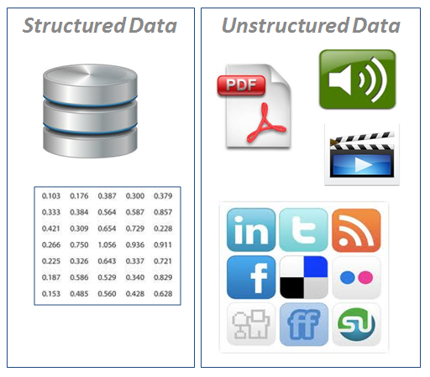
Structured Vs. Unstructured Data

Slide 4
Examples of Unstructured Data
Examples include
Personal messaging – email, instant messages, tweets, chat
Business documents – business reports, presentations, survey responses
Web content – web pages, blogs, wikis, audio files, photos, videos
Sensor output – satellite imagery, geolocation data, scanner transactions

Slide 5
What is Text Mining?
Text Mining is also known as Text Data Mining (TDM) and Knowledge Discovery in Textual Database (KDT)
A process of identifying novel information from a collection of texts (Also known as a ‘Corpus’)
Corpus is a collection of ‘documents’ containing natural language text. Here, documents, generally, are sentences. Each document is represented as a separate line.

Slide 6
Text Mining – Example
Playing It My Way is the autobiography of former Indian cricketer Sachin Tendulkar
It was launched on 5 November 2014 in Mumbai
The book summarises Tendulkar's early days, his 24 years of international career and aspects of his life that have not been shared publicly
Soon after it’s launch, Twitter was flooded with emotions, comments and thoughts by the readers around the world
The following data was retrieved from Twitter

Slide 7
Data Snapshot (.txt File)
no mention of match fixing. Silent on Controversial issues
good to read.
not a great book.
Only sachin's fan can read
Match fixing not touched
He could have written more about his colleagues
I will prefer to watch his old matches.
Silent on match fixing.
Good to read about his early days.
Good book.
Not for avid readers.
Only for Sachin fans.
Had high hopes about revealing match fixing.
Excellent book
The book is worth reading

Slide 8
Text Mining in R
As a result of Text mining of the above document we will get to know:
Most frequently appearing word in the text in graphical (bar chart),pictorial (word cloud) and tabular format.
Sentiment score for each respondent (Negative, Positive, Neutral etc.)

Slide 9
Text Mining in R
# Import text file with one text record in one row
data<-readLines(file.choose())
head(data)
[1] "no mention of match fixing. Silent on Controversial issues"
[2] "good to read."
[3] "not a great book."
[4] "Only sachin's fan can read"
[5] "Match fixing not touched"
[6] "He could have written more about his colleagues"
# Convert data into corpus
library(tm)
corp <- Corpus(VectorSource(data))
class(data) is character
A ‘vector source’ interprets each element of the vector as a document.
class(corp)
[1] "SimpleCorpus" "Corpus"

Slide 10
Text Mining in R
# Clean the corpus for further analysis
# Convert to lower case and remove punctuation
corp <- tm_map(corp, tolower)
corp <- tm_map(corp, removePunctuation)
# Remove numbers
corp <- tm_map(corp, removeNumbers)
# Remove stop words like: and, the, is, etc.
corp <- tm_map(corp,removeWords, stopwords("english"))
# Display a particular document from corpus
writeLines(as.character(corp[[1]]))
# Inspect corpus
inspect(corp[1:3])
tm_map()
applies transformation functions to a corpus
If you wish to remove specific words from the corpus use
tm_map(corp, removeWords, “word”)

Slide 11
Text Mining in R
tdm <- TermDocumentMatrix(corp)
findFreqTerms(tdm)
# Find terms with frequency of at least 10
findFreqTerms(tdm,10)
[1] "fixing" "match" "good" "read" "book“
# Find words having high association with 'fixing'
findAssocs(tdm, 'fixing', 0.30)
$fixing
match silent issues
0.92 0.54 0.33
Term Document Matrix gives number of times each word (term) appears in each document.
Try DocumentTermMatrix()

Slide 12
Word Cloud
library(wordcloud)
# Convert to a matrix
m <- as.matrix(tdm)
m
Docs
Terms 1 2 3 4 5 6 7 8 9 10 …….. 62
controversial 1 0 0 0 0 0 0 0 0 0
fixing 1 0 0 0 1 0 0 1 0 0
issues 1 0 0 0 0 0 0 0 0 0
match 1 0 0 0 1 0 0 1 0 0
mention 1 0 0 0 0 0 0 0 0 0
silent 1 0 0 0 0 0 0 1 0 0
good 0 1 0 0 0 0 0 0 1 1
read 0 1 0 1 0 0 0 0 1 0
book 0 0 1 0 0 0 0 0 0 1
……

Slide 13
Word Cloud
# Calculate the total frequency of words
v <- sort(rowSums(m), decreasing=TRUE)
myNames <- names(v)
d <- data.frame(word=myNames, freq=v)
# Create colour palette
pal2 <- brewer.pal(8,"Dark2")
# Word cloud
wordcloud(d$word, d$freq,random.order = FALSE , min.freq=1, colors=pal2)
brewer.pal () was developed by Cynthia Brewer.
It makes the color palettes from Color Brewer
available as R palettes.
Arguments:
Number of colors included in the palette: 8
Palette Name: Dark 2
random.order=FALSE plots words in decreasing frequency.

Slide 14
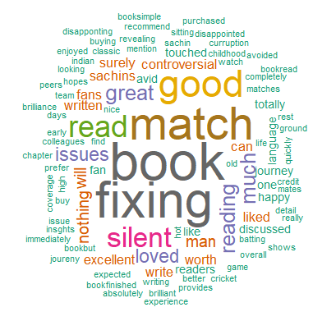
Word Cloud

Slide 15
Using ggplot
# Using ggplot
term.freq <- rowSums(m)
term.freq <- subset(term.freq, term.freq >= 10)
# Transform as a dataframe
df <- data.frame(term = names(term.freq), freq = term.freq)
library(ggplot2)
ggplot(df, aes(x = term, y = freq))+
geom_bar(stat = "identity") +
xlab("Terms") + ylab("Count") + coord_flip()
Object term.freq is of class numeric

Slide 16
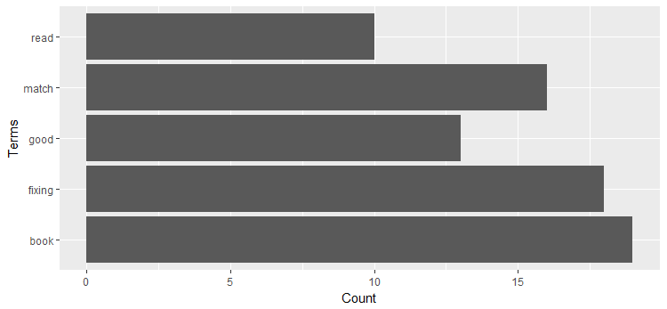
Bar Chart Using ggplot()

Slide 17
What is Sentiment Analysis?
Sentiment Analysis is the process of determining whether a piece of writing is positive, negative or neutral.
It determines the emotional tone behind words, typically categorizing sentiments as positive, negative, or neutral.
This analysis helps businesses understand customer opinions, monitor brand reputation, and improve customer experiences by analyzing reviews, social media posts, and other textual data sources.

Slide 18
Sentiment Analysis in R
# Package for sentimental analysis
install.packages("RSentiment") # You may need to install package rJava
library(RSentiment)
# Import text file with one text record in one row
data<-readLines(file.choose())
head(data)
# Calculate sentiment score of each document
calculate_score(data)
….
[1] 0 1 -1 1 -1 1 1 1 1 1 -1 1 1 1 2 0 1 -1 2 -1 2 0
[23] 0 2 2 1 3 0 2 0 1 2 1 2 2 0 -1 0 1 -1 1 1 -1 3
[45] 0 3 1 -2 -1 -1 3 1 0 2 3 -1 3 1 0 1 4 2
Scores:
0 indicates neutral sentiment
positive value indicates positive sentiment
negative value indicates negative sentiment
99 indicates sarcasm

Slide 19
Sentiment Analysis in R…
# Display the summary of sentiment score of all the documents
calculate_total_presence_sentiment(data)
[,1] [,2] [,3] [,4]
[1,] "Sarcasm" "Neutral" "Negative" "Positive"
[2,] "0" ”11" ”11" ”21"
[,5] [,6]
[1,] "Very Negative" "Very Positive"
[2,] "1" ”18"

Slide 20
Sentiment Analysis in R – Using Package "syuzhet"
Syuzhet is an R package for the extraction of sentiment and sentiment-based plot arcs from text.
The name “Syuzhet” comes from the Russian Formalists Victor Shklovsky and Vladimir Propp who divided narrative into two components, the “fabula” and the “syuzhet.” Syuzhet refers to the “device” or technique of a narrative whereas fabula is the chronological order of events. Syuzhet, therefore, is concerned with the manner in which the elements of the story (fabula) are organized (syuzhet)
The package is more suitable for analysis of sentiment trajectory across a text document.

Slide 21
Sentiment Analysis in R – Using Package "syuzhet"...
Syuzhet incorporates four sentiment lexicons:
“syuzhet” (Default) : Developed in the Nebraska Literary Lab under the direction of Matthew L. Jockers
“afinn” : Developed by Finn Arup Nielsen as the AFINN WORD DATABASE
“bing” : Developed by Minqing Hu and Bing Liu as the OPINION LEXICON
“nrc” : Developed by Mohammad, Saif M. and Turney, Peter D. as the NRC EMOTION LEXICON.
These lexicons contain words tagged with sentiment values, which are typically positive, negative, or neutral.
get_nrc_sentiment() is a useful function for analysing sentences in terms of emotions and sentiments. NRC Emotion Lexicon: Tags words with various emotions and sentiment categories.

Slide 22
get_nrc_sentiment is a function from the syuzhet package in R, which is used to perform sentiment analysis using the NRC Emotion Lexicon. This lexicon assigns words to various emotions (anger, anticipation, disgust, fear, joy, sadness, surprise, trust) and sentiment categories (positive, negative).

Slide 23
Sentiment Analysis in R – Using Package "syuzhet"...
# Display emotions and sentiment scores for each document
library(syuzhet)
nrcsentiment <- get_nrc_sentiment(data)
head(nrcsentiment)
anger anticipation disgust fear joy sadness surprise trust negative positive
1 1 0 0 0 0 0 0 0 1 0
2 0 1 0 0 1 0 1 1 0 1
3 0 0 0 0 0 0 0 0 0 0
4 0 0 0 0 0 0 0 0 0 0
5 0 0 0 0 0 0 0 0 1 0
6 0 0 0 0 0 0 0 0 0 0

Slide 24
After obtaining the sentiment scores using the get_nrc_sentiment function, there are several actions you can take to further analyze and utilize the sentiment information.
Summary Statistics and Aggregation
Compute summary statistics to get an overall sense of the sentiment in your dataset. This could include:
Average sentiment scores
Distribution of sentiment categories
Proportion of positive vs. negative sentiment

Slide 25
Remark:
Text mining can be applied to any language, although the complexity and effectiveness of the process may vary depending on the language and the available tools and resources.
Many text mining libraries and tools support multiple languages. Here are some popular ones:
NLTK (Python): Offers support for multiple languages, including tokenization, stop words, and stemming.
SpaCy (Python): Provides language models for various languages, including tokenization, POS tagging, named entity recognition (NER), etc.
TextBlob (Python): Supports basic text processing tasks for several languages.
Tidytext (R): Works with various languages through tokenization and text mining functions.
Syuzhet (R): Supports sentiment analysis in multiple languages using different lexicons.

Slide 26
THANK YOU!!

